Slide 1
Project Report
Name : Chandrika Sagar (c807472@gmail.com)
Title :Smart Agriculture System Based on IoT
Category:Internet Of Things
I nternship at s martinternz.com@2020

Slide 2
SMART AGRICULTURE SYSTEM BASED ON IOT
Aim and Scope:
Smart Agriculture System based on Iot can monitor soil moisture and climatic conditions to grow and yield a good crop. The farmer can also get the real-time weather forecasting data by using external platforms like Open Weather API. Farmer will be provided a mobile app using which he can monitor the temperature, humidity and soil moisture parameters along with weather forecasting details. Based on all the parameter, farmer can water his crop by controlling the motor using the mobile application. Thus even if the farmer is not present near his crop he can water his crop by controlling the motors using the application from anywhere.
The Project Flow can be seen from the following
diagram:

Slide 3
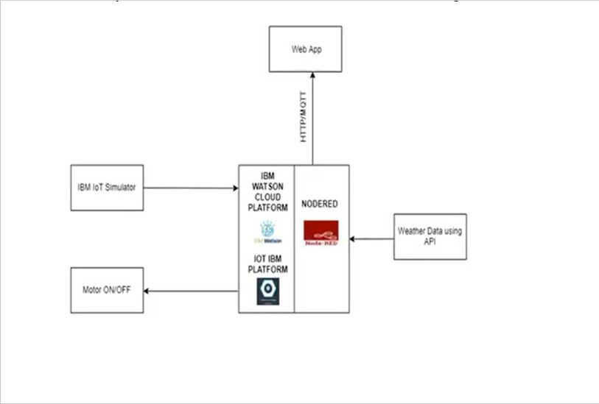
Project Deliverables:
Creating a platform to have the services used to create the app by checking out IBM's Cloud Platform.
The device used to set the temperature and humidity by Connecting the IoT Simulator for the Watson IoT platform.
Configure Node-Red to retrieve data from the IBM IoT platform and Open Weather API, Which is used to get the current weather using OpenWeather.
Creating a Web App to preview our red code.
Configure your device to retrieve information from the web app and control your motors.
Check the weather the motor keys work well and give effect.
These are the project deliverables that need to be delivered.
Project Team: Chandrika sagar

Slide 4
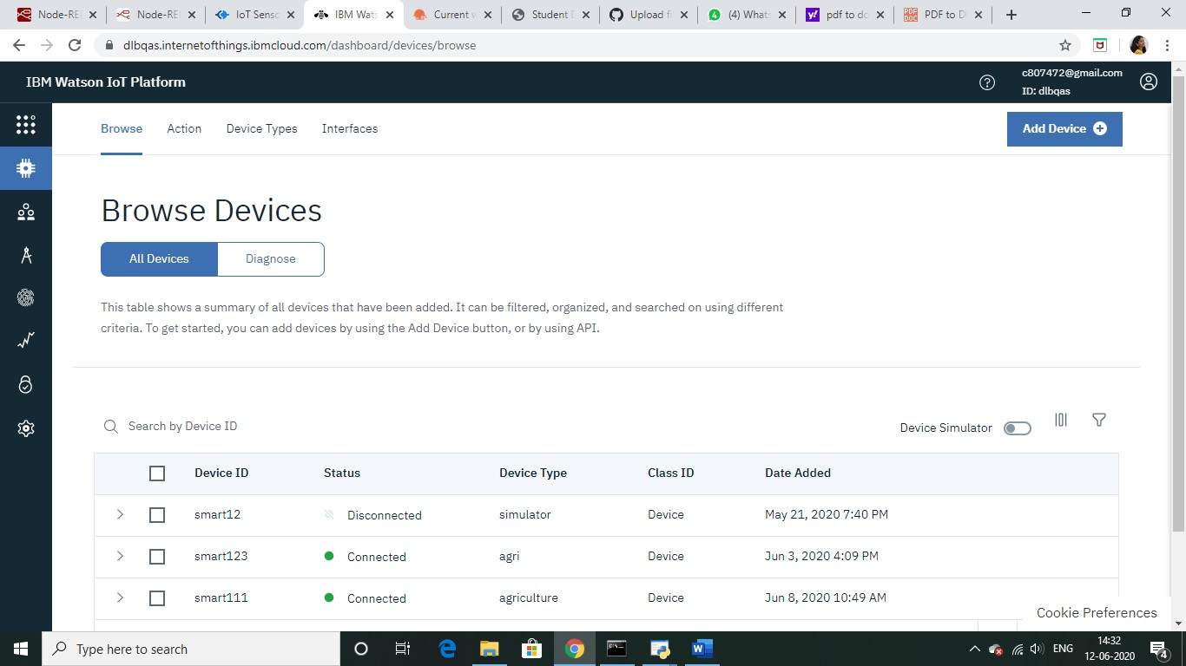
Getting Sensor Inputs into IBM Cloud :
First task to build the web app is to get the sensor data in the cloud. I am using IBM cloud for this. We need an IBM account for the same. Steps to take sensor data in the cloud:
Sign up for IBM Academic Initiative Account using this link.
After this Sign up for IBM Cloud using link.
Go to IBM Watson IOT Platform by searching IOT platform in the catalogue in
IBM
Cloud
4.Go to the IOT Platform and now we will create a device here after which we will get the credentials for IOT simulator.

Slide 5
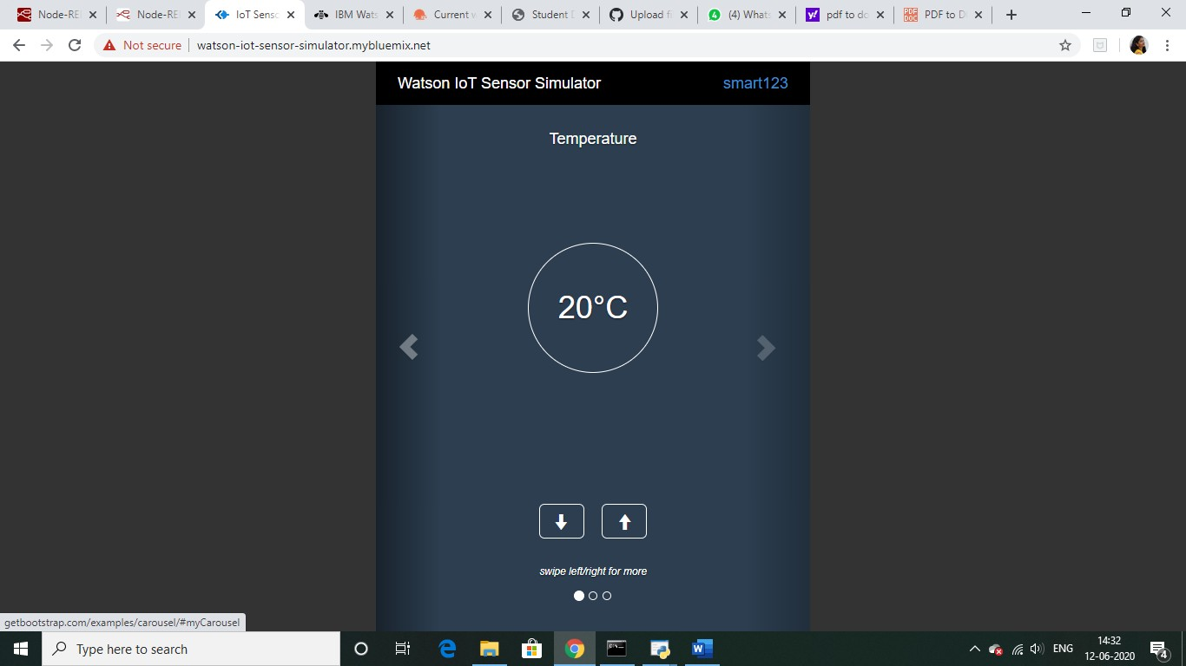
5.You will get Device credentials save them in a notepad so that we connect to IOT simulator. Go to linkfor IOT simulator. The following screen appears once
your simulator get’s
connected.
6. Now
in the cloud we can create cards to view the simulator
data.

Slide 6
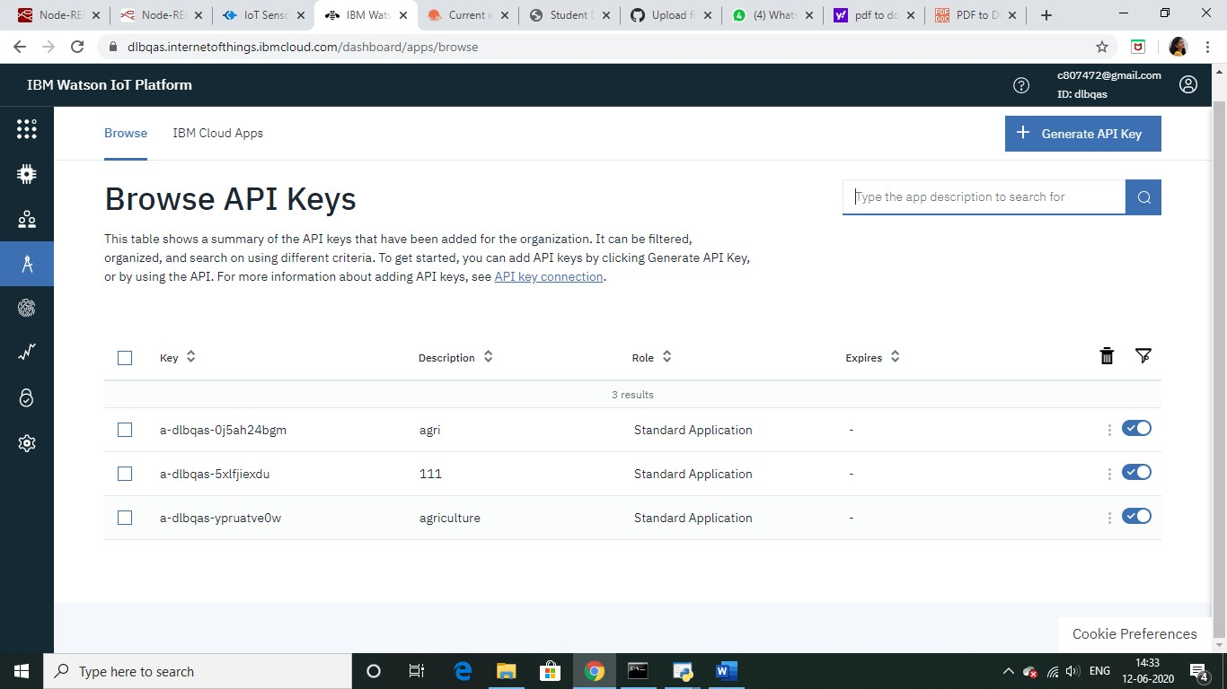
Node-Red
Now once we got the data in the cloud, we will use node red to get the data in a web app. To install node-red in windows follow this link. After this we would need to externally install IBM iot node in node red using the below code.
Node-red-contrib-scx-ibmiotapp
We would need 3 flows:
To take the weather data from OpenWeather API.
To take sensor data from the IBM cloud.
Finally, to transfer the motor control data to the cloud.
Flow1

Slide 7
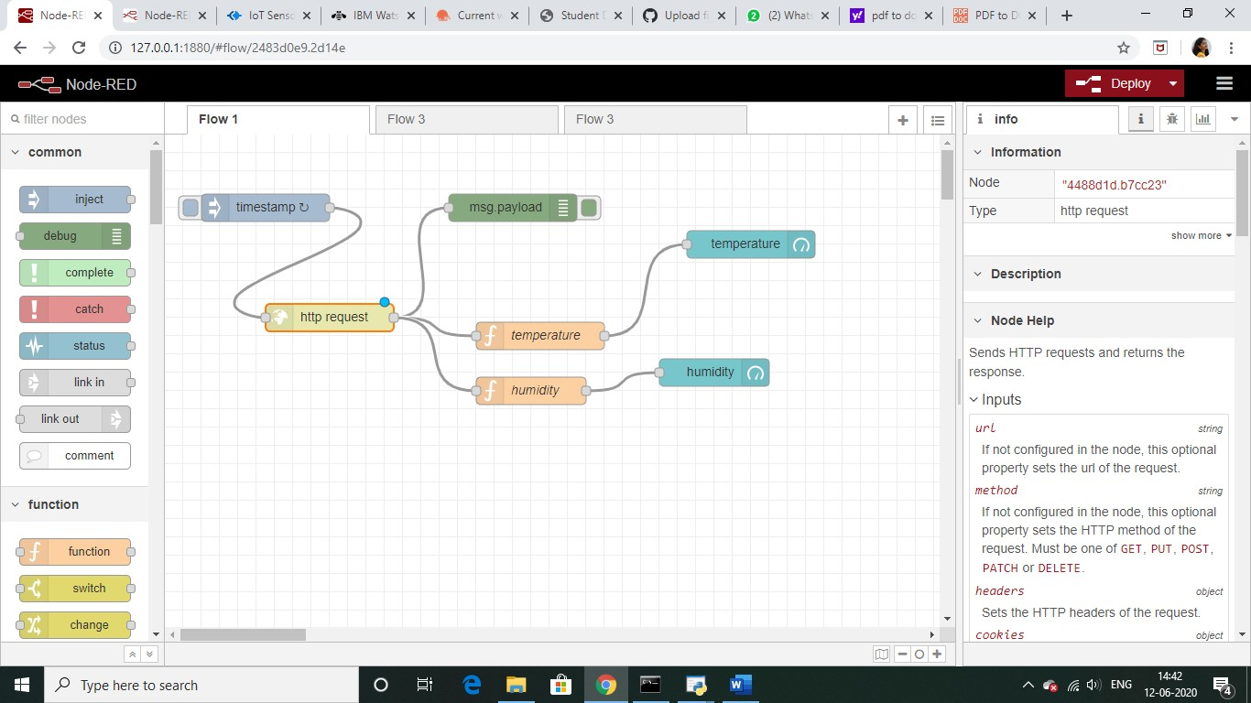
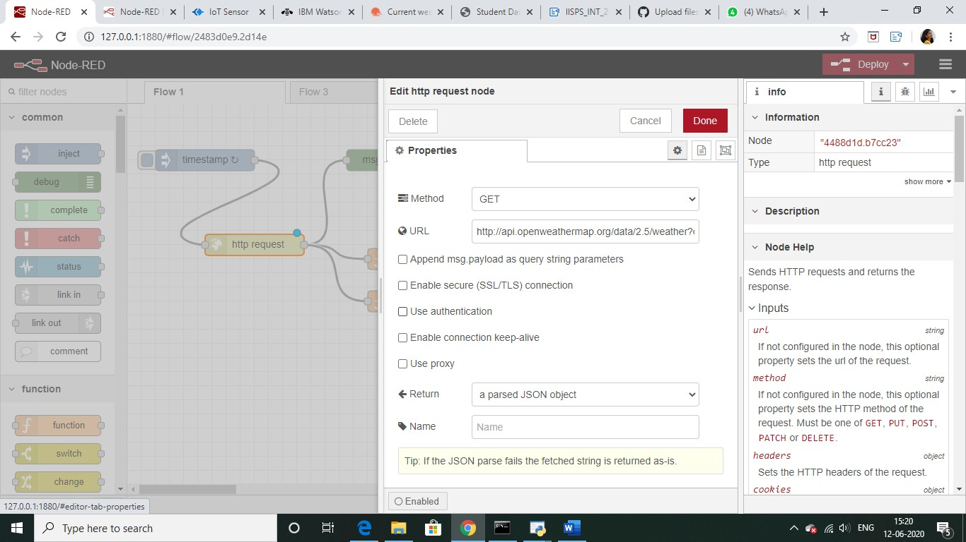
In this the settings for the function nodes and http nodes are as follows:
FLOW-2

Slide 8
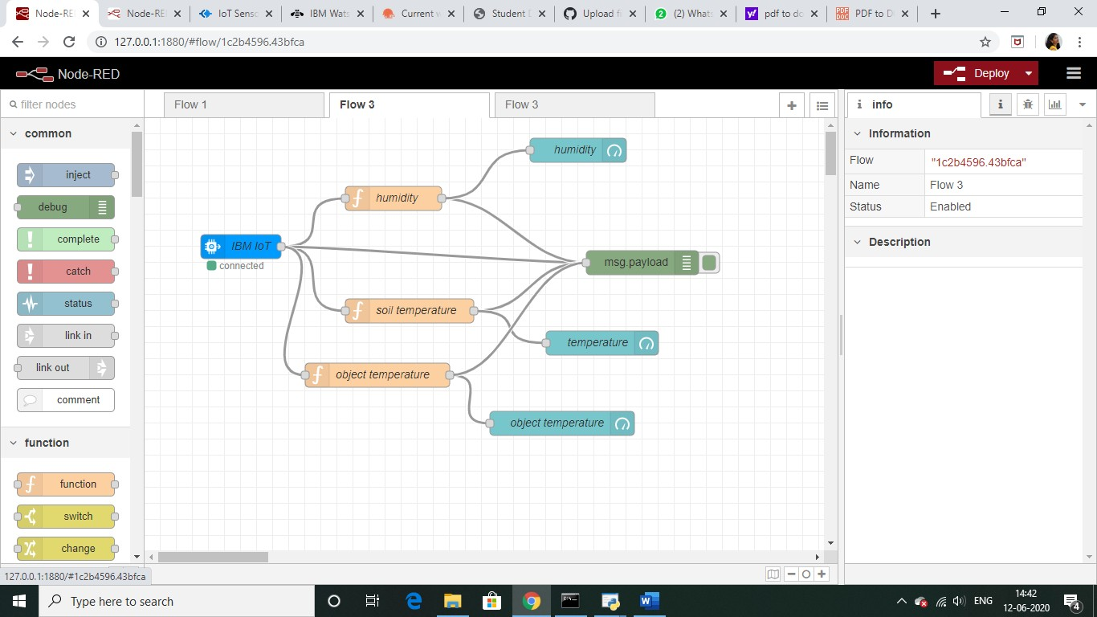
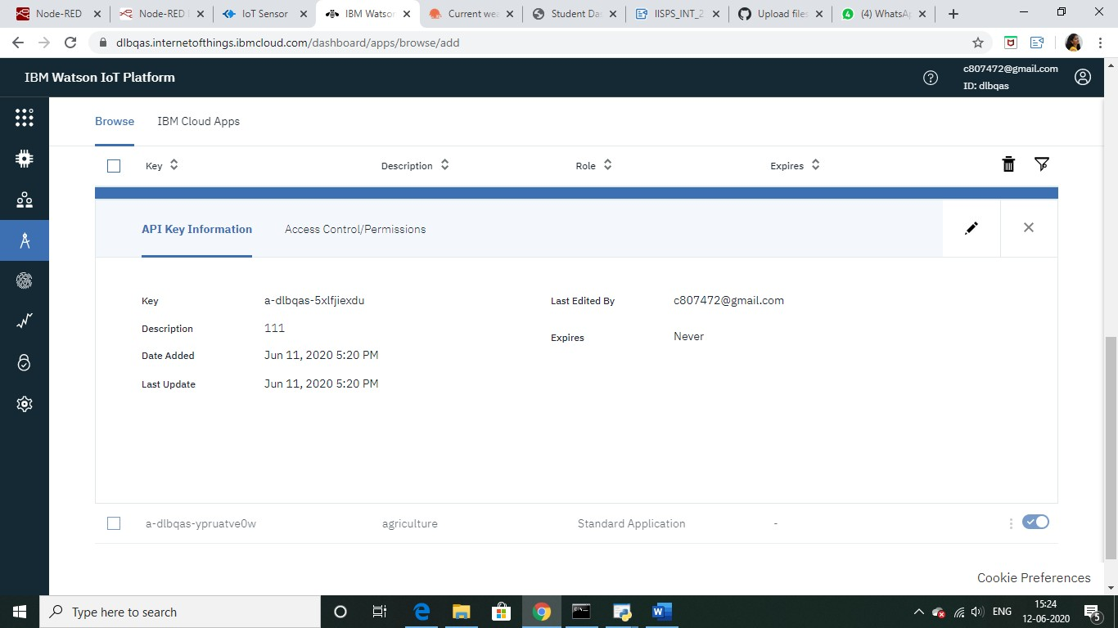
Now we need to put API in IBM IOT node which we can get form IBM cloud from Apps tab.

Slide 9
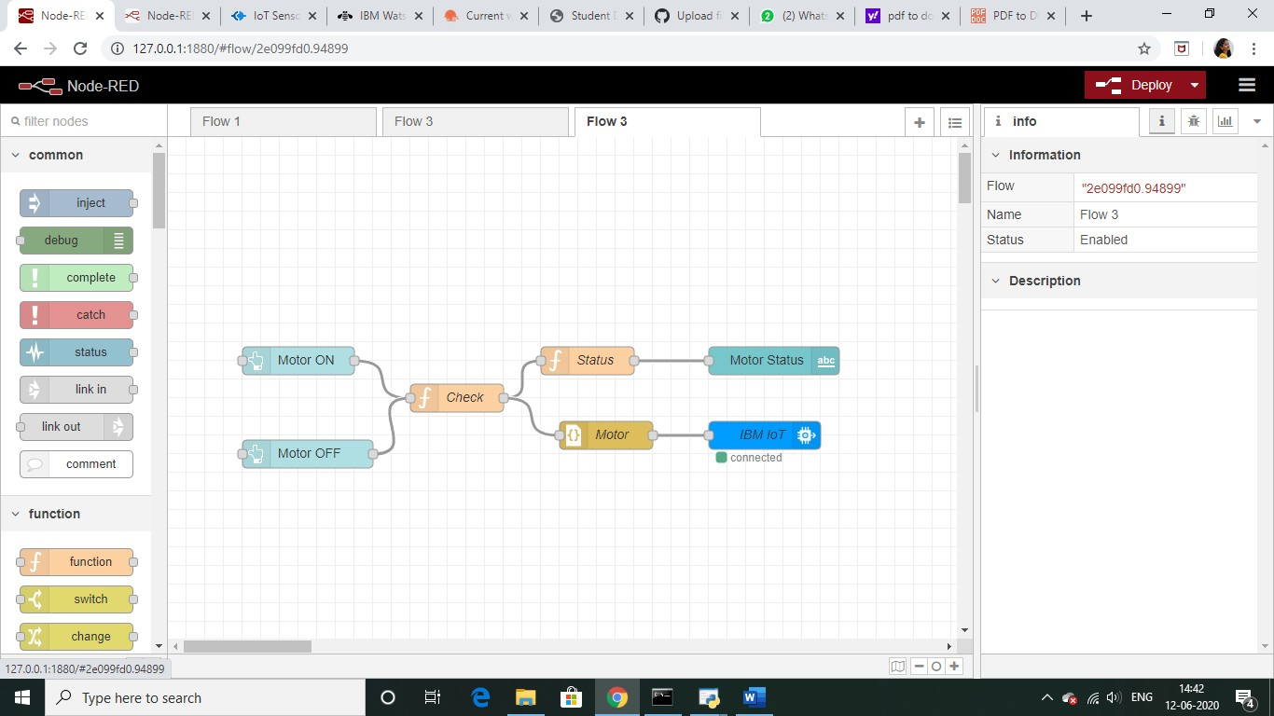
FLOW-3
Code for “Motor Status Check”
if(msg.payload === true) msg.payload = '{"command":"ON"}' else
msg.payload = '{"command":"OFF"}'
return msg;
Code for “status”
var data=JSON.parse(msg.payload); msg.payload=data.command; return msg;
Settings for “MOTOR” and Buttons

Slide 10
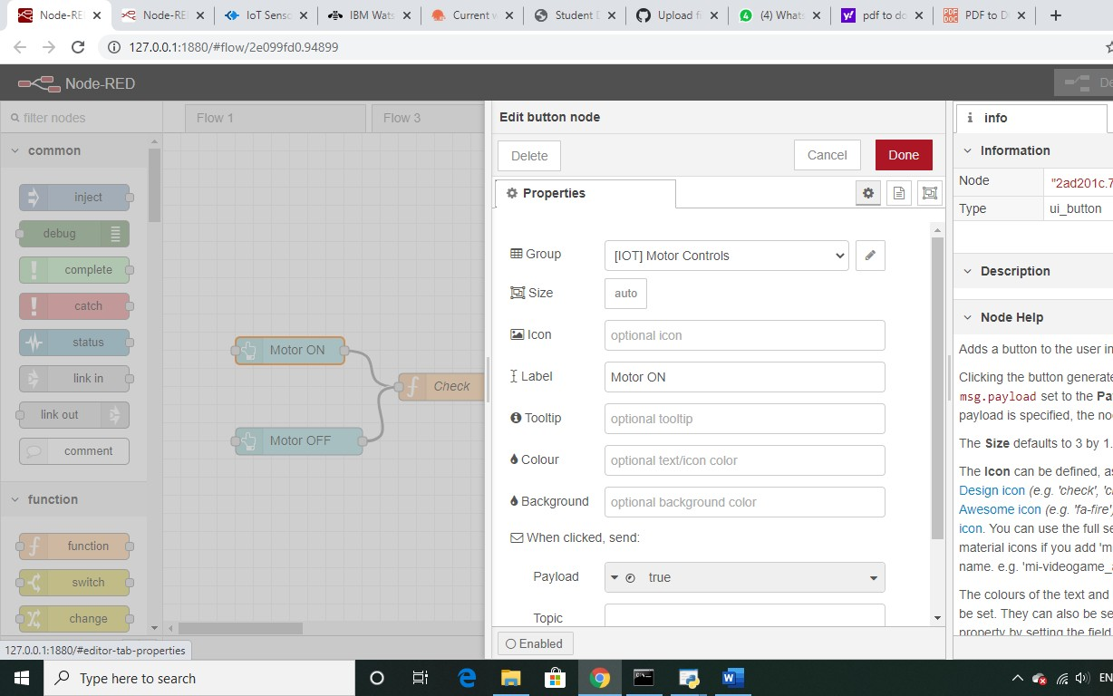
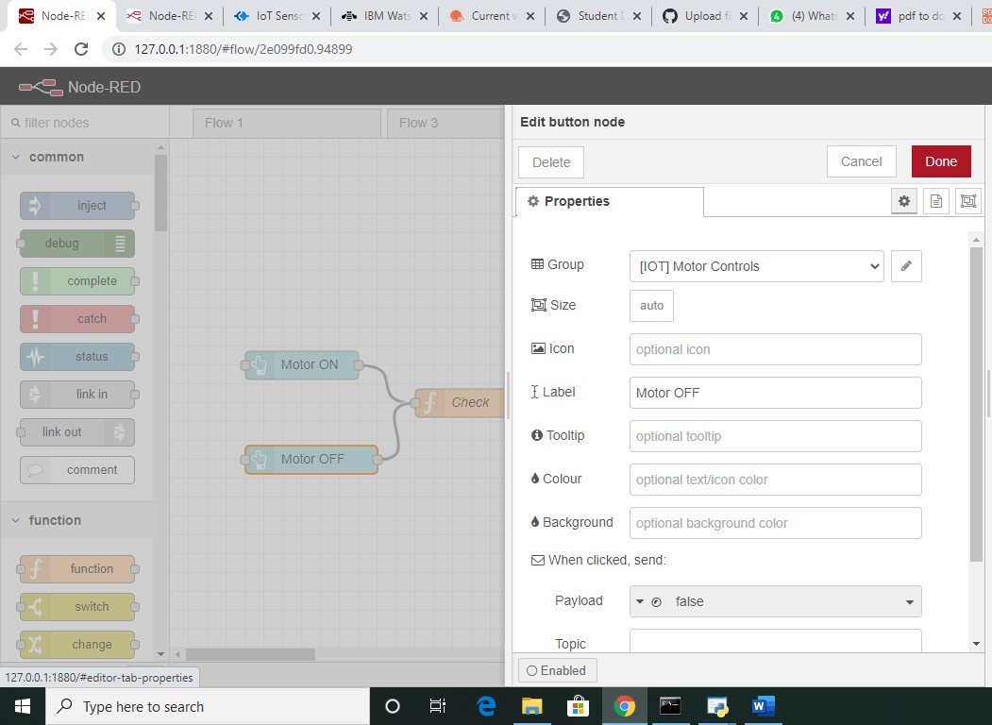

Slide 11
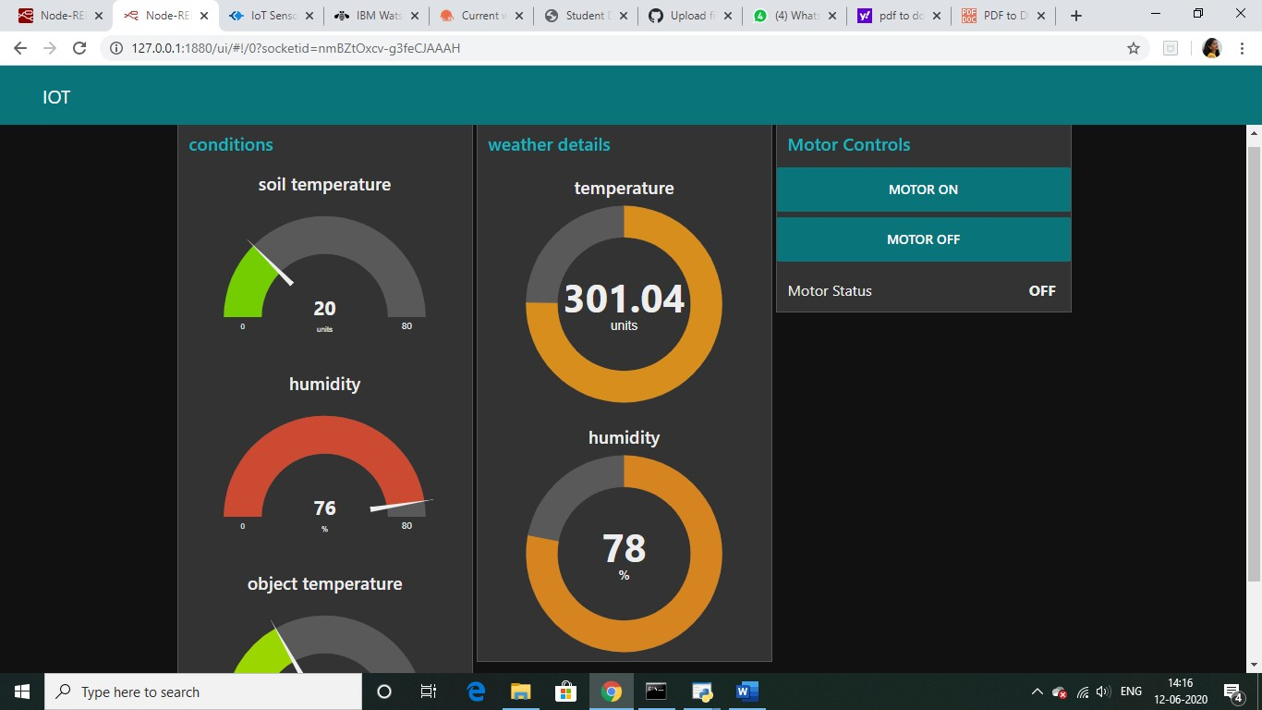
Web APP
Python program to receive commands from Watson IOT platform
import time
import sys
import ibmiotf.application
import ibmiotf.device
organization = "dlbqas" #replace the ORG ID deviceType = "agriculture"#replace the
Device type wi deviceId = "smart111"#replace Device ID authMethod = "token"
authToken = "Chandrika12#Replace the authtoken

Slide 12
def myCommandCallback(cmd): # function for Callback
print("Command received: %s" % cmd.data) if cmd.data['command']=='motoron': print("MOTOR ON IS RECEIVED")
elif cmd.data['command']=='motoroff':
print("MOTOR OFF IS RECEIVED")
if cmd.command == "setInterval":
if 'interval' not in cmd.data:
print("Error - command is missing required information: 'interval'")
else:
interval = cmd.data['interval'] elif cmd.command == "print":
if 'message' not in cmd.data:
print("Error - command is missing required information: 'message'")
else: output=cmd.data['message']
print(output)

Slide 13
try:
deviceOptions = {"org": organization, "type": deviceType, "id": deviceId, "auth-method":
authMethod, "auth-token": authToken}
deviceCli = ibmiotf.device.Client(deviceOptions) #..............................................
except Exception as e:
print("Caught exception connecting device: %s" % str(e)) sys.exit()
#Connect and send a datapoint "hello" with value "world" into the cloud as an event of type "greeting" 10 times
deviceCli.connect()
while True:
deviceCli.commandCallback = myCommandCallback
#Disconnect the device and application from the cloud
FINAL OUTPUT

Slide 14
